Slide 1



${BASES}_{AI\&CYBERSECURITY}$
Prepared by : Kejsi Bushi, Genti Haveri

Slide 2
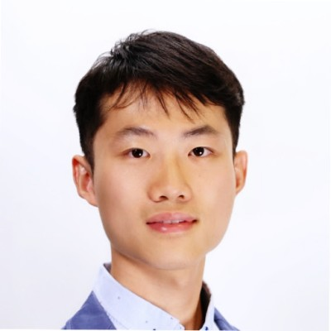
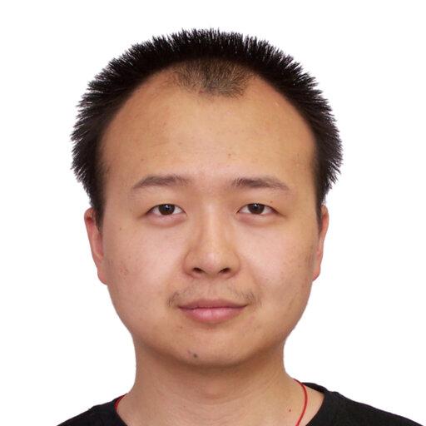


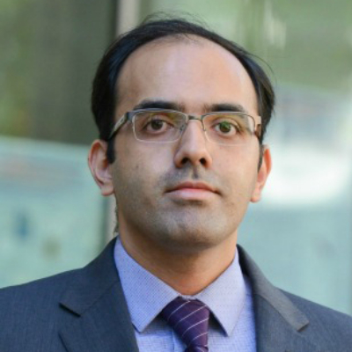
Authors
Zikui Cai
Chengyu Song
Srikanth Krishnamurthy
Amit Roy-Chowdhury
M. Salman Asif

Slide 3
Table of contents
01
02
03
04
05
06
Introduction
BASES Approach
Experiments
Performance and Comparisons
Applications and Use-Cases
Limitations

Slide 4
01
INTRODUCTION

Slide 5
DEEP NEURAL NETWORK(DNN)
What is a DNN?
A deep neural network (DNN) enables machines to learn complex patterns and representations from data with unprecedented accuracy. When adequately trained, DNNs allow machine learning (ML) models to reliably interpret images, mimic realistic human-like speech, and even generate pieces of art.
A deep neural network is a type of artificial neural network (ANN) with multiple layers between its input and output layers. Each layer consists of multiple nodes that perform computations on input data. Another common name for a DNN is a deep net.

Slide 6
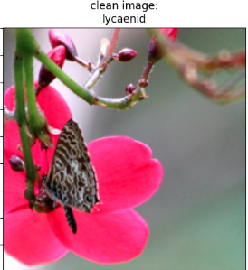
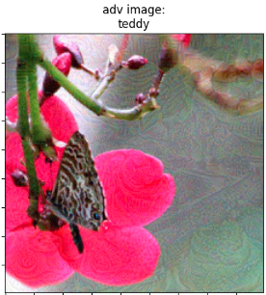

DNN & ADVERSARIAL ATTACKS
Deep Neural Networks (DNNs) have achieved state-of-the-art performance across various domains such as image recognition, natural language processing, and speech recognition. However, despite their impressive capabilities, DNNs are highly vulnerable to adversarial attacks—deliberate manipulations of input data designed to fool the network into making incorrect predictions.
+
=

Slide 7
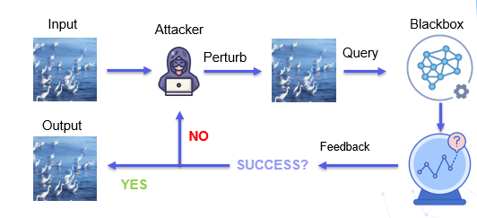
Introduction ~ What are Blackbox Attacks?
Blackbox attacks target machine learning models where the attacker has no access to internal parameters or architecture.
Highlight vulnerabilities in AI systems.
Used to test model robustness and security.

Slide 8

Transfer-based vs Query-Based Attacks
Transfer-based attacks
Query-based attacks
Attack surrogate model(s) and test the perturbation on the victim model
PROS: does not need feedback
CONS: low success rate
Update permutations by iteratively querying the victim model
PROS : high success rate
CONS : requires a large number of queries

Slide 9
TARGET VS UNTARGET ATTACKS
TARGET ATTACKS
Force the model to predict a specific incorrect label (the "target").
Offers precision in the attack outcome
f(x*) = y*
Example: CAT -> DOG
UNTARGET ATTACKS
Push the model away from the correct label to any other incorrect label
Easier to achieve since disrupting the model's decision boundaries doesn't require precise targeting.
f(x*) ≠ y*
Example : CAT -> CARROT

Slide 10
2
BASES APPROACH

Slide 11
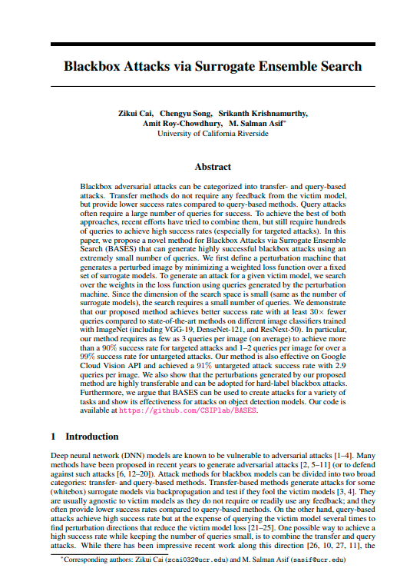
BASES APPROACH
What BASES stands for?
Blackbox Attacks via Surrogate Ensemble Search
What is the key idea ?
Use a mix of multiple models (surrogate models) and adjust their contributions (weights) based on feedback from the target model.
Why we use it?
high successful rate (by adapting perturbation to victim model)
Extremely small query counts (search space is low-dimensional)
3 QUERIES PER IMAGE !!!

Slide 12
BASES: Combining Transfer and Query Attacks
Transfer – Based Component
Query – Based Component
Uses surrogate models (white-box models) to generate initial adversarial perturbations.
Relies on the assumption that if an adversarial example can fool multiple surrogate models, it is likely to fool the victim model too.
Directly queries the victim (black-box) model to refine adversarial examples.
The victim model's feedback is used to adjust the perturbation iteratively for better effectiveness.

Slide 13
HOW DOES BASES WORK
Perturbation Machine
Weight Search
Efficiency:
Adjust weights for the models to maximize the attack's success.
Fewer adjustments because the search space is small.
Dynamically adjusts weights of surrogate models.
Targets the victim model for successful adversarial attacks.
Small search space due to fewer weights (same as the number of surrogate models).
Significantly fewer adjustments and queries compared to traditional methods.

Slide 14
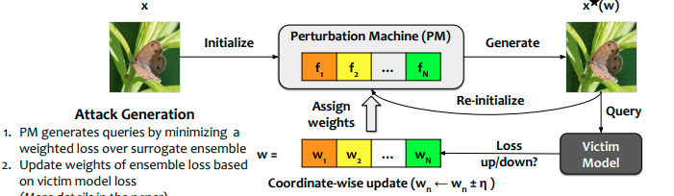
How does BASES work?

Slide 15
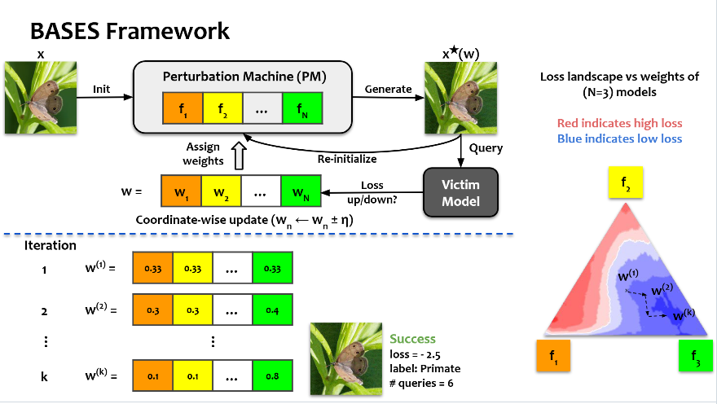

Slide 16
What is PM and why do we use a surrogate ensemble?
The Perturbation Machine (PM) is a system that generates adversarial examples by slightly altering inputs to challenge the robustness of models. It produces a single perturbation to fool all the (whitebox) models in the surrogate ensemble.
We use a surrogate ensemble for two reasons:
1) It is known to provide better transfer attacks.
2) A single surrogate model provides a fixed perturbation; hence, it does not offer flexibility to search over perturbations.

Slide 17
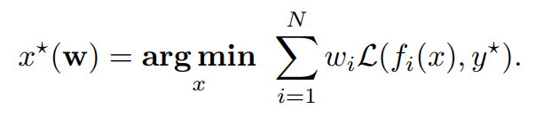
How Perturbation Machine Works?
Combines predictions from multiple surrogate models.
Uses a weighted loss function to adjust the adversarial perturbation
Input image → Add small perturbation → Minimize loss for surrogate ensemble → Generate perturbed image x∗
Uses simple iterative optimizations(PGD)

Slide 18
How Does Surrogate Ensemble Search Work
Starts with equal weights for all surrogate models (w=[1/N,…,1/N]w=[1/N,…,1/N]).
Queries the victim model for feedback.
Adjusts weights ww coordinate by coordinate (one weight at a time) to find the best combination:
Update rule: wn±ηwn​±η (small step size ηη).
The update rule modifies the weights of the surrogate ensemble coordinate-by-coordinate to minimize the victim model's adversarial loss LvLv​. This process is known as coordinate descent.

Slide 19
3
EXPERIMENT

Slide 20
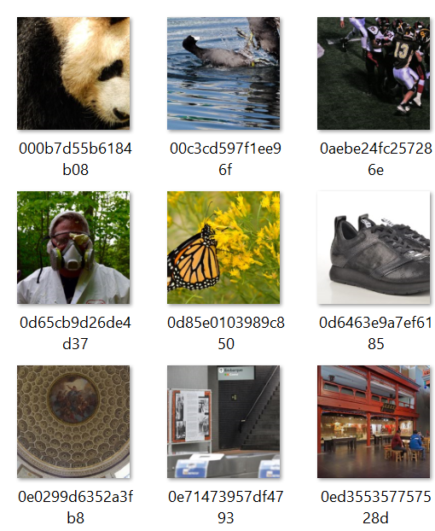
Experiment Design
DATASET:
1000 ImageNet-like images (NeurIPS-17).
Google Cloud Vision API for real-world testing.
MODELS:
Surrogate ensemble (20 models, e.g., VGG-16, ResNet-18).
Victim models (VGG-19, DenseNet-121).
METRICS:
Query count, fooling rate, perturbation norms (l∞,l2l∞​,l2​).

Slide 21
RESULTS: TARGETED ATTACKS
Bases Performance:
Achieves over 90% success rates for targeted attacks on popular victim models.
Requires as few as 3 queries per image on average.
At least 30× fewer queries compared to state-of-the-art methods like TREMBA and GFCS.
Victim Models Tested:
Pretrained ImageNet models used as blackbox victim classifiers:
VGG-19
DenseNet-121
ResNeXt-50
BASES successfully fools diverse architectures, demonstrating generalizability

Slide 22
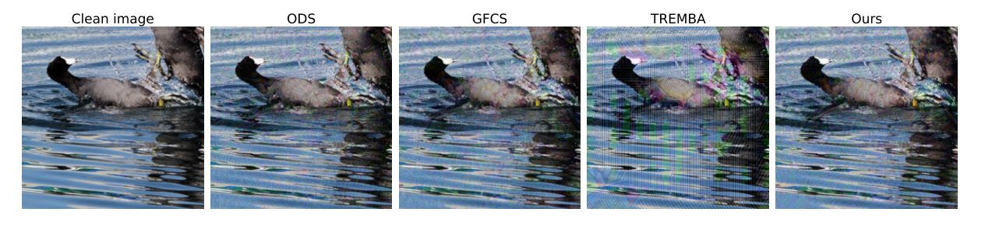
COMPARISON WITH OTHER METHODS
TREMBA
Requires ~100 queries to achieve similar success rates.
BASES outperforms it in query efficiency and fooling rate.
GFCS:
Lower success rate under limited query budgets.
Relies on single-model surrogate gradients, whereas BASES uses an ensemble.

Slide 23
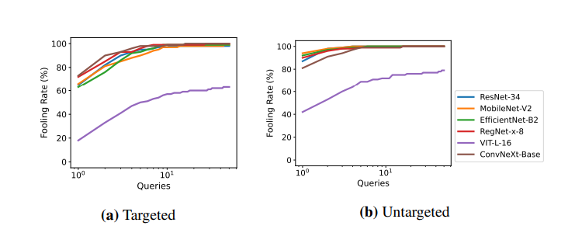
TRANSFERABILITY
What is transferability ?
Transferability refers to the ability of adversarial perturbations generated for one model (surrogate model) to successfully fool other, unseen models (victim models).
This is a crucial feature for black-box attacks where the attacker has no access to the victim model.
Why is Transferability Important for BASES?
BASES aims to create perturbations that work across multiple models with minimal queries.
Perturbations generated by a diverse surrogate ensemble have a higher chance of transferring to different victim models.

Slide 24
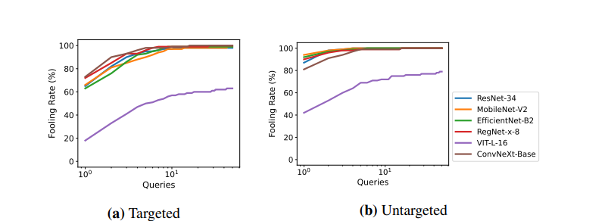
HARD –LABEL BLACK-BOX CLASSIFIERS
Hard-label classifiers return only the top prediction label without confidence values.
These are often used in real-world applications, like cloud services (e.g., Google Cloud Vision).
BASES is effective against hard-label black-box classifiers.
Achieves a 63% improvement in fooling rate compared to traditional methods on challenging models.

Slide 25
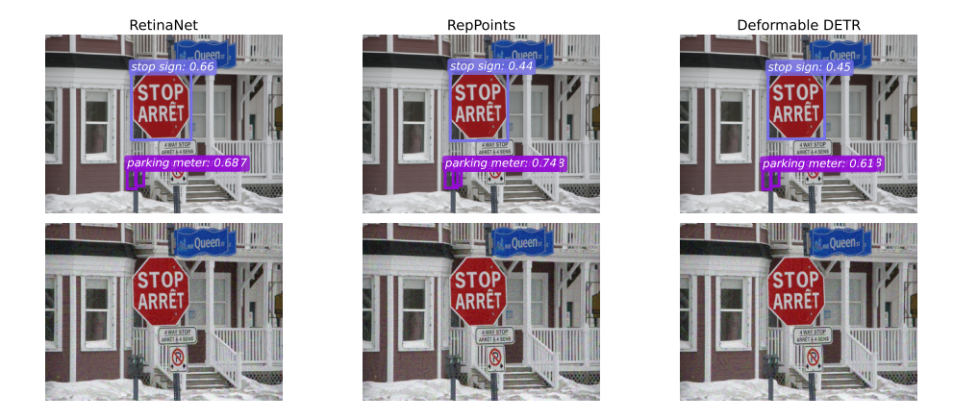
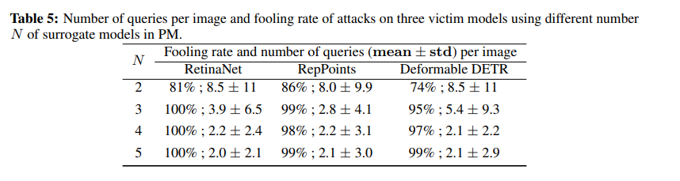
OBJECT DETECTION
While BASES is primarily tested on image classification, it can also be applied to object detection tasks.
Object detection involves identifying objects within an image and classifying them, often with bounding boxes.

Slide 26
4
Some of Our Experiments

Slide 27
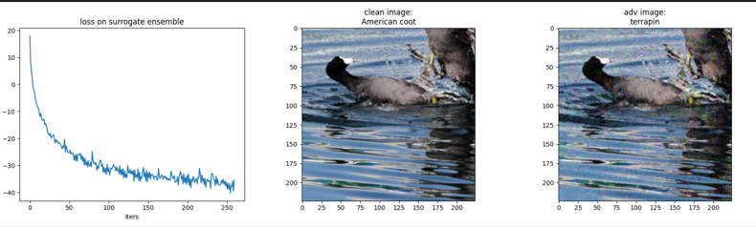
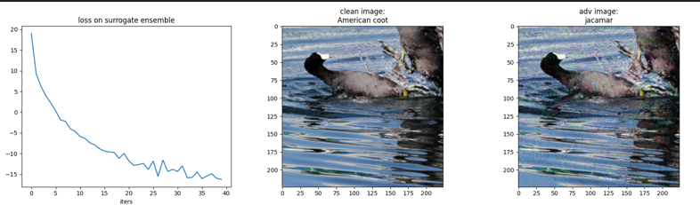
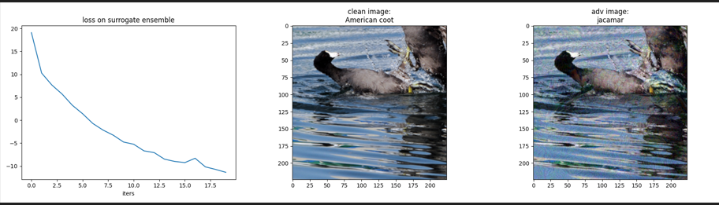
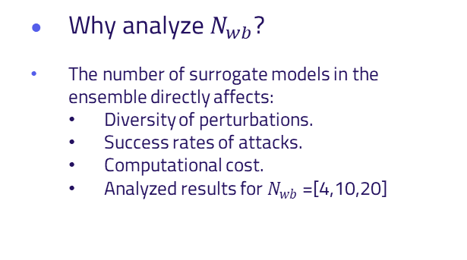
Impact of Number of Models in the Ensemble
Why analyze $N_{wb}$?
The number of surrogate models in the ensemble directly affects:
Diversity of perturbations.
Success rates of attacks.
Computational cost.
Analyzed results for $N_{wb}$ =[4,10,20]
a) N = 4
Results:
N = 4 --> Avg queries : 8.28; success rate: 0.53
N = 10 --> Avg queries : 6.01; success rate: 0.87
N = 20 --> Avg queries : 3.12; success rate: 0.98
* For targeted attack
b) N = 10
c) N = 20

Slide 28
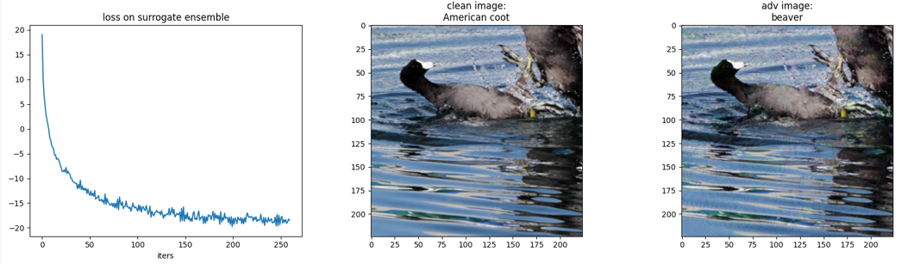
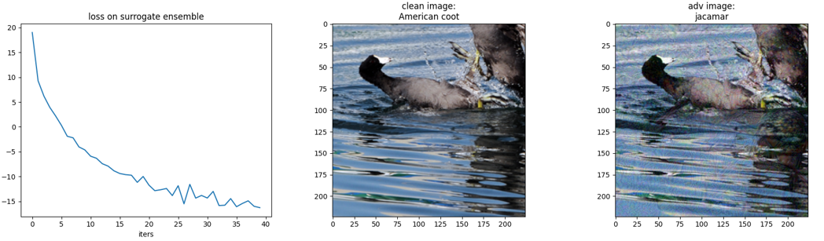
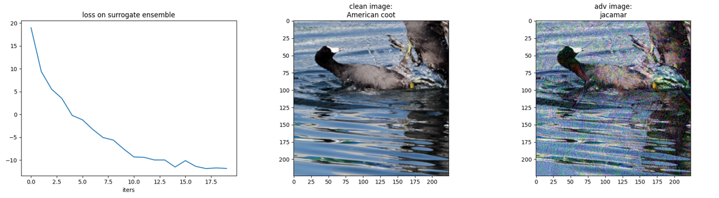
IMPACT OF PERTURBATION BOUND
Why analyze ϵ?
Perturbation bound (ϵ) defines the maximum allowable distortion:
l∞​-norm: Pixel-wise changes constrained to ±ϵ.
a) ϵ = 8
Results:
ϵ = 8 --> Avg queries : 12.22; success rate: 0.58
ϵ = 16 --> Avg queries : 6.01; success rate: 0.87
ϵ = 32 --> Avg queries : 3.01; success rate: 0.98
* For targeted attack
b) ϵ = 16
c) ϵ = 32

Slide 29
5
Real-world Application: Google Cloud Vision API

Slide 30
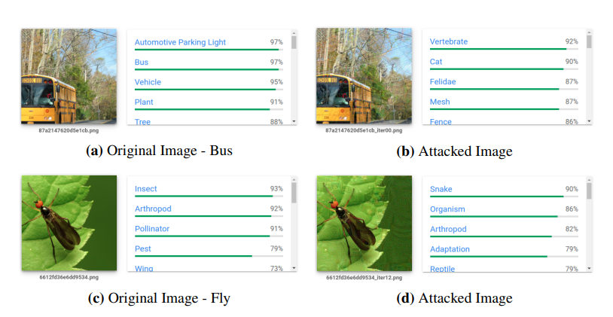
Google Cloud Vision API (GCV) Results
Why Test on Google Cloud Vision API?
The Google Cloud Vision API (GCV) is a commercial image classification service that works as a black-box for adversarial attack testing.
No access to the model's architecture, parameters, or gradients—just the model’s predictions (labels and probabilities).
Results:
Success Rate: BASES achieved 91% untargeted attack success with only 2.9 queries per image on average.

Slide 31

LIMITATIONS
Dependence on Surrogate Ensemble Diversity
Limitation: BASES relies on a diverse ensemble of surrogate models to generate successful adversarial perturbations.
Impact: The quality and diversity of the surrogate models directly influence the transferability and effectiveness of the attacks. If the surrogate models are too similar or limited in diversity, the perturbations may not transfer well to the victim model.

Slide 32
LIMITATIONS
Need for Large Surrogate Ensemble:
Limitation: While using a larger ensemble (N=20) increases attack success rates, it also increases the computational time for generating adversarial examples.
Impact: The balance between ensemble size and computational efficiency remains a challenge. In some cases, a smaller ensemble may still work but may require additional fine-tuning.

Slide 33
CONCLUSION
BASES combines transfer-based and query-based attacks for high success with minimal queries.
Achieves 90%+ success with only 3 queries per image.
91% success on Google Cloud Vision API with 2.9 queries per image.
30× more efficient than existing methods like TREMBA.
Future work: Improve query efficiency and extend to new domains

Slide 34
THANK YOU!
https://github.com/kejsibushi20/AI-Cybersecurity?tab=readme-ov-file

